Slide 1
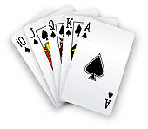
All-In
BY:
Shagun Uppal
Sarthak Bhagat

Slide 2
PROCESS
Detecting state and rank
Thresholding
Extracting Cards
Edge Detection
Matching

Slide 3
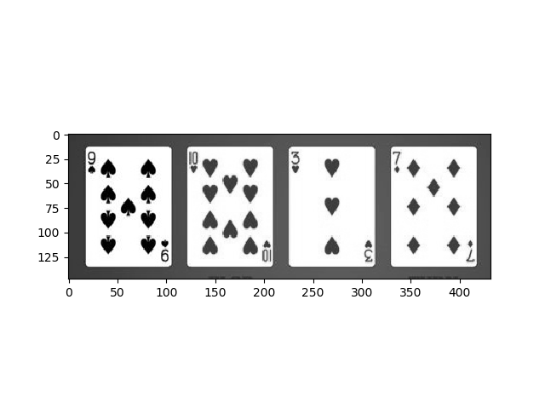
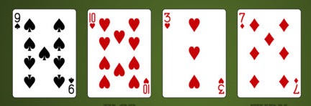
RGB to Grayscale Image
No essential edge information in the coloured channels, hence, no need for complexity (in terms of code/algorithm complexity and time complexity).

Slide 4
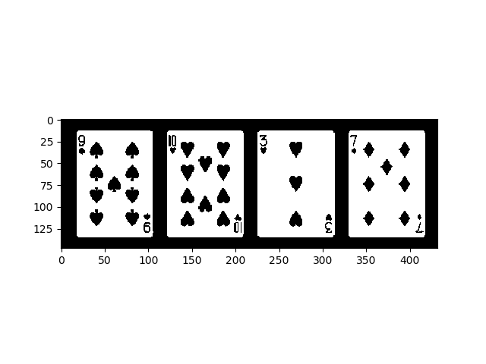
Thresholding : Trivial Binarization and Otsu Method
Iterate over various thresholds for the differentiation of foreground from background
Choose the threshold that minimises the variance spread in foreground and background intensities.
We try to minimise the variance within class and maximise the variance between classes.

Slide 5
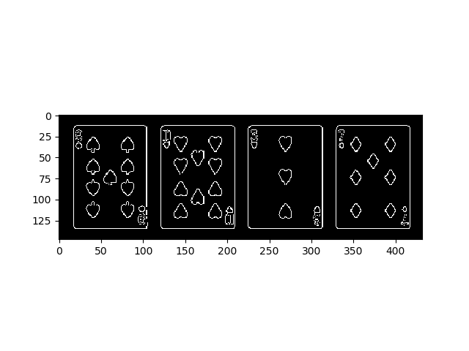
Contour Extraction using Canny Method
Gaussian Filter for smoothing the image
Apply Gradient Filters for edge detection
Applying Non-Max Suppression to get rid of fake response to edge detection
Apply Double Threshold to get the potential edges
Track edges by Hysteresis

Slide 6
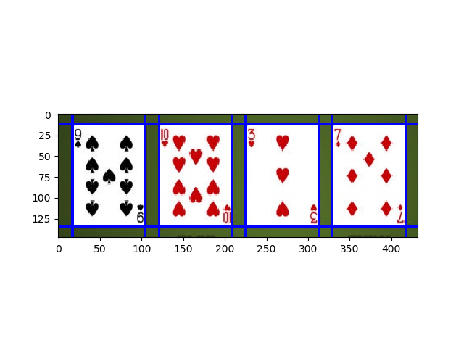
Hough Transform
We find the distance of normal from origin (rho) and the angle formed with positive x-axis (theta) for segments obtained.
We plot these to obtain sinusoidal curves, the point of intersection of these curves gives us the rho and theta, from which we can get the line describing the edge.

Slide 7
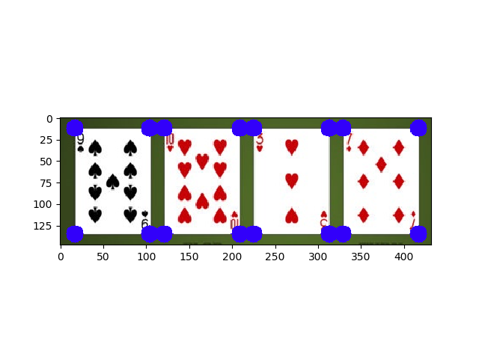
Extracting Card Bounding Boxes

Slide 8
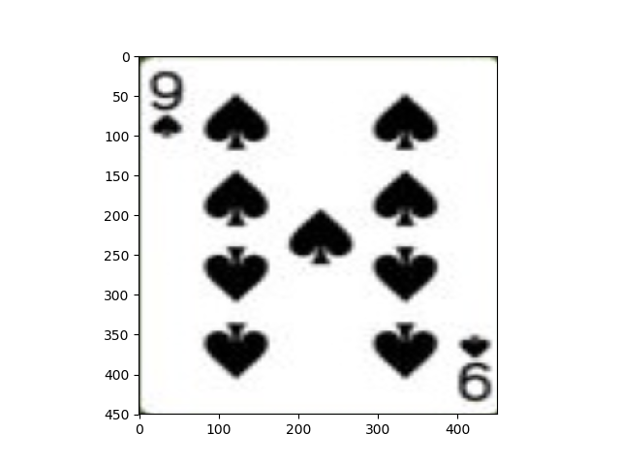
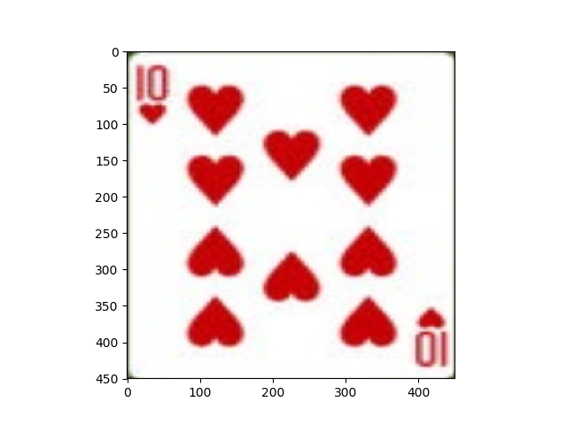
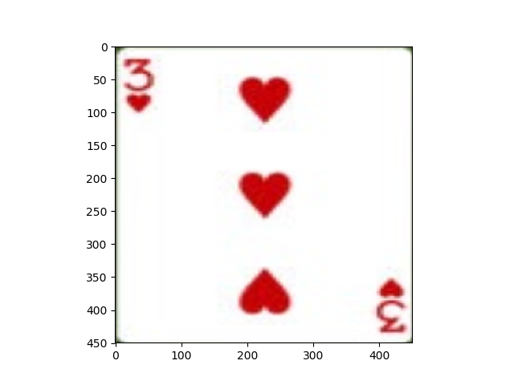
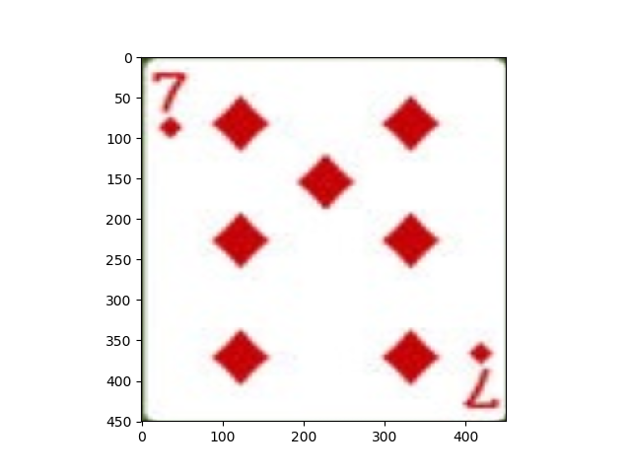

Slide 9
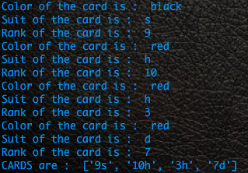
Template Matching to Detect Suit and Rank of Card
Convolve the image with the template image, and report the presence of a particular sub-image if it passes a certain set threshold.

Slide 10
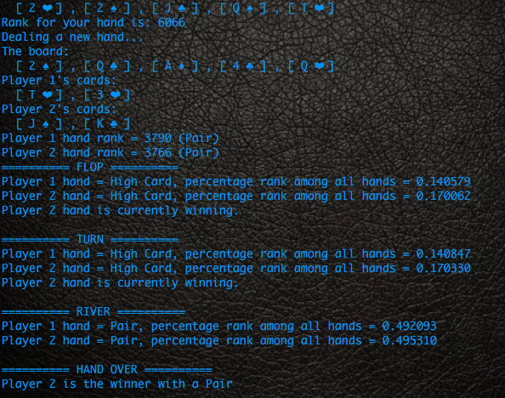
Predicting current state and recommending

Slide 11
Future Prospects
We can create completely autonomous poker playing model which detects the state and recommends using our model, then makes the optimal move.
We can train separate models for predicting the score of a pair of user’s cards given the number, suit and rank of unfolded cards on the board, helping us to choose the best possible move.

Slide 12
Thank you!

